Slide 1

Vacationer…we make life fun!
Saogat, Shannon, Siyan, & Gary

Slide 2

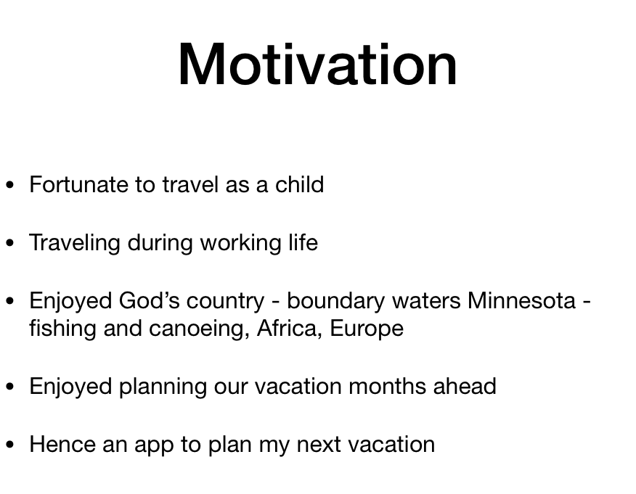



Slide 3
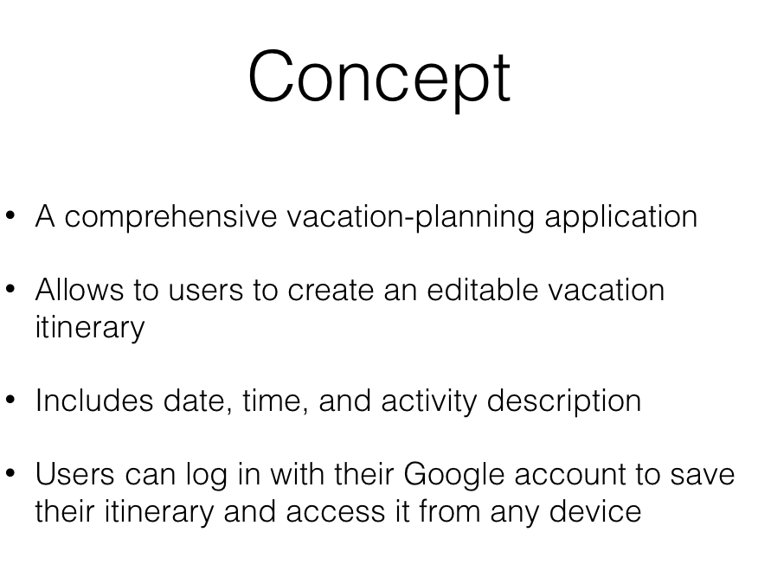

Slide 4
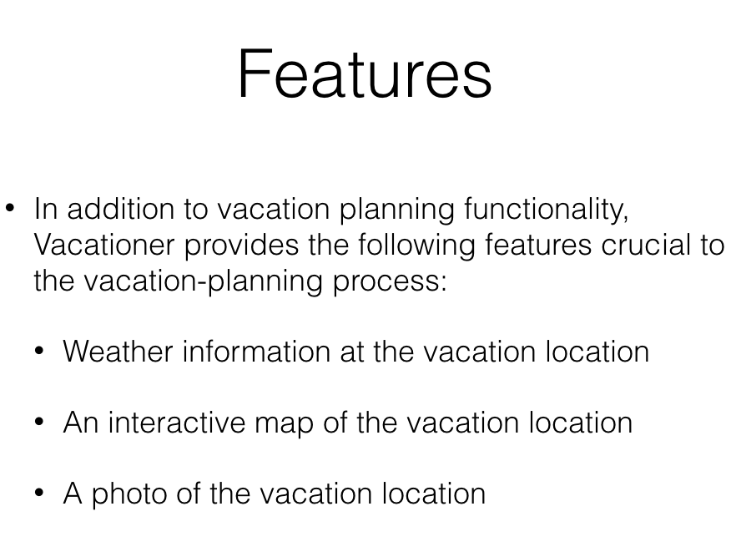
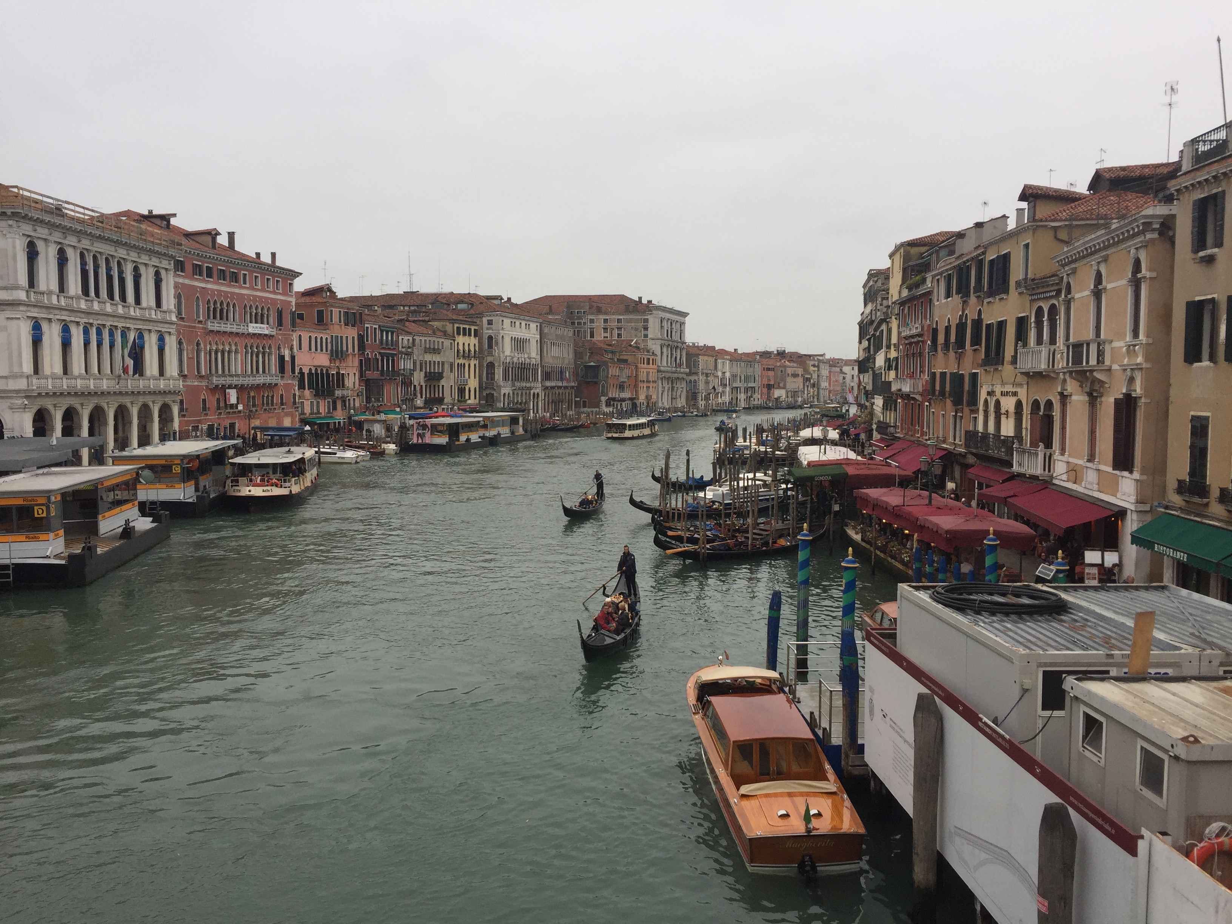


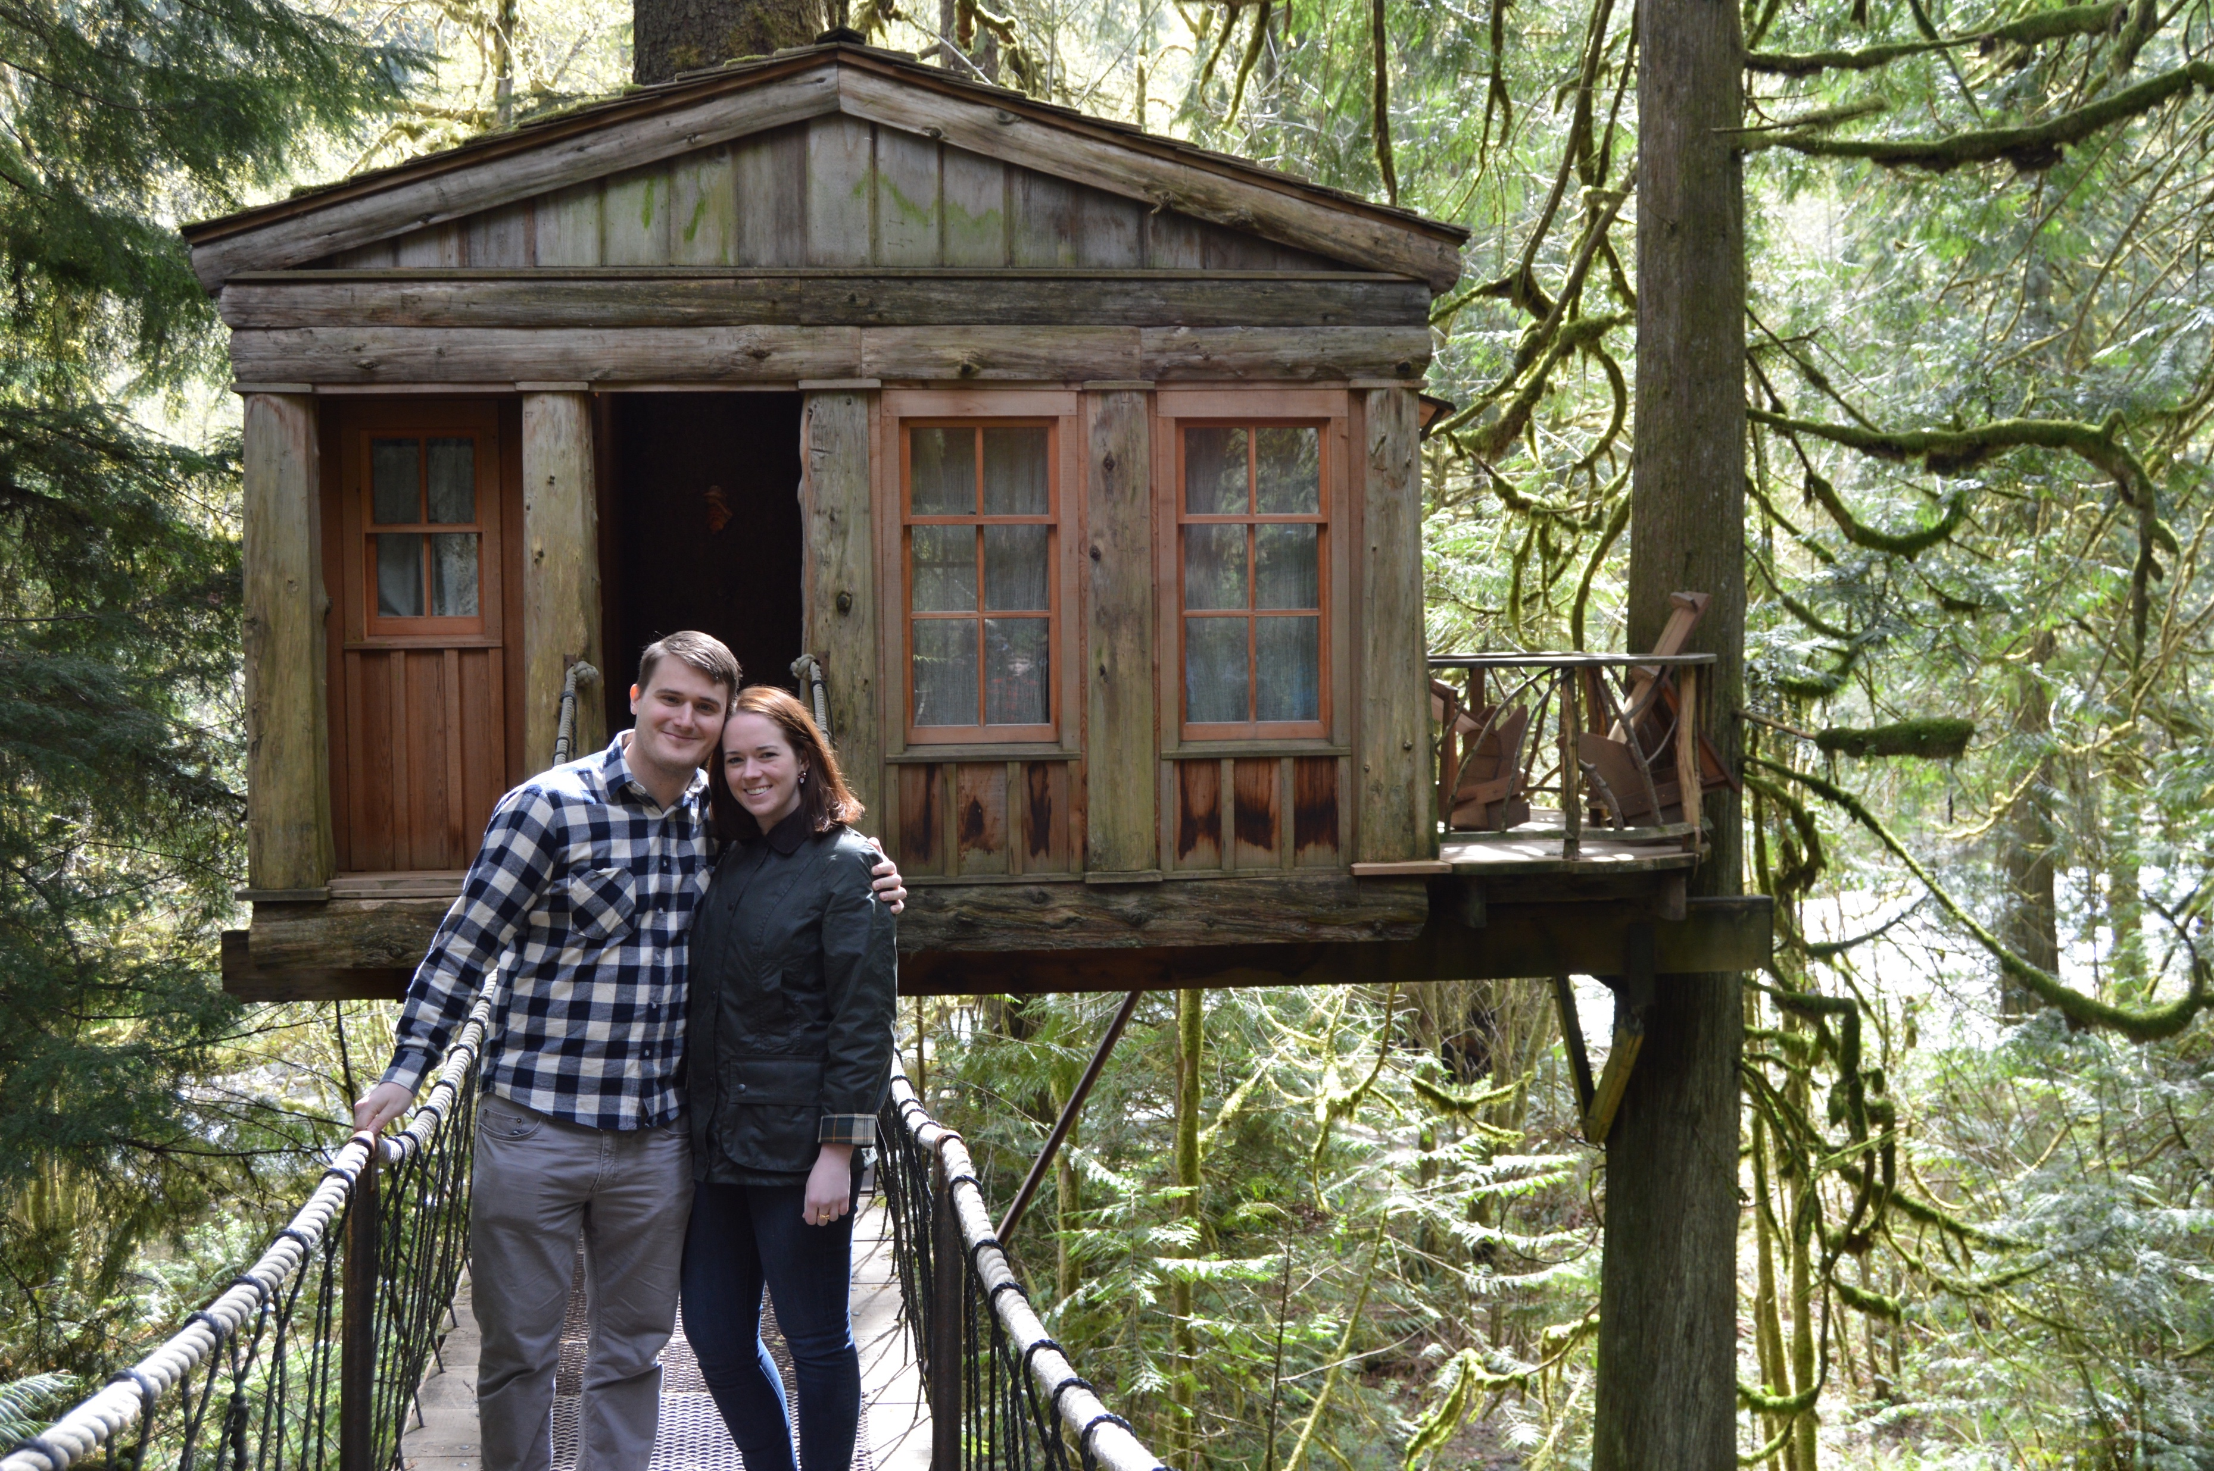

Slide 5


Slide 7

Technology
Firebase & google login API
Data persistence
User can login to the website to save
the locations and associated activities.

Slide 8
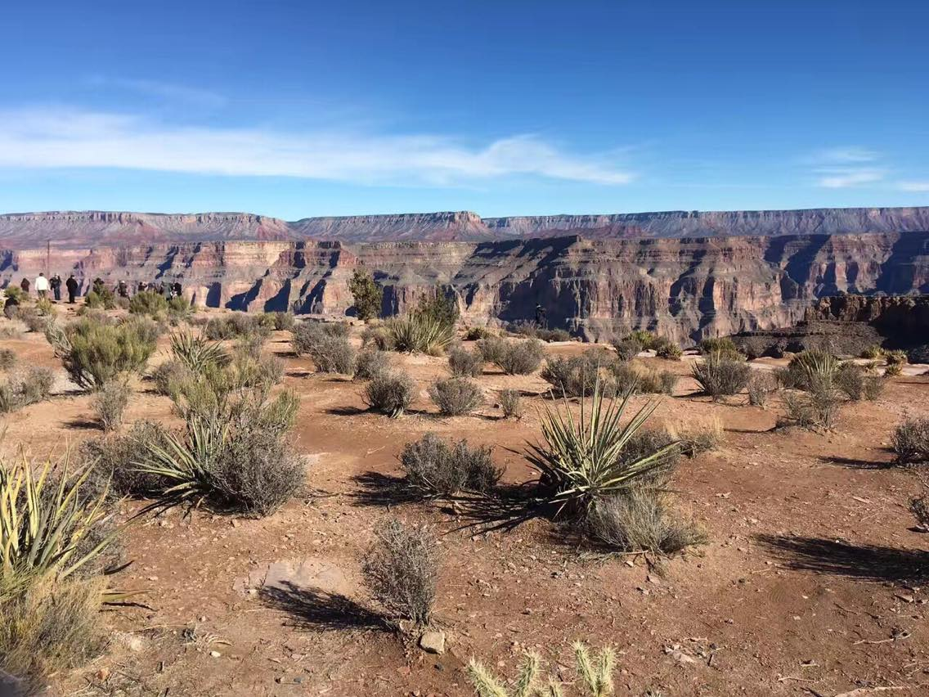
Main features:
OpenWeather API
Weather Data: weather description, temperature(min/max), humidity
Google map API
Allow user to see and explore the city they selected on google map
Pixabay API
most popular picture of each city user selected

Slide 9

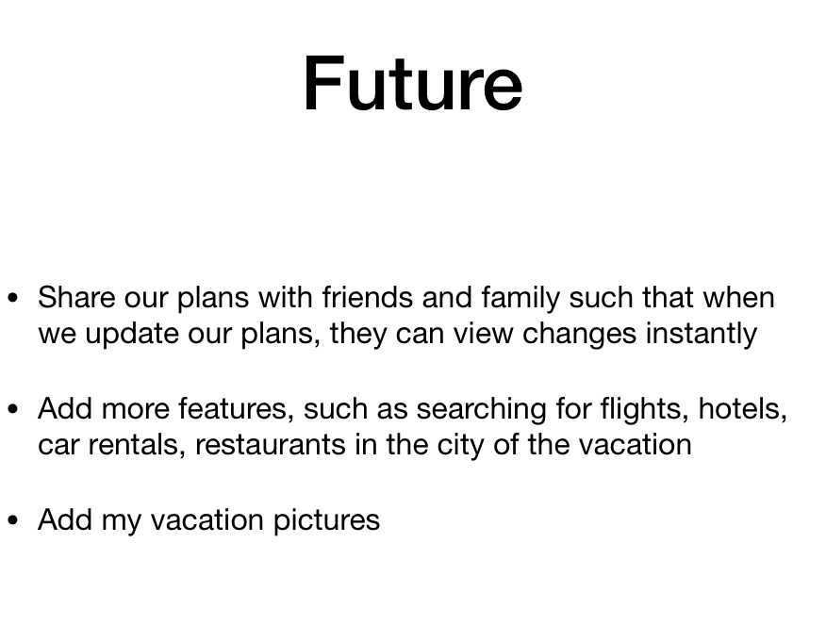

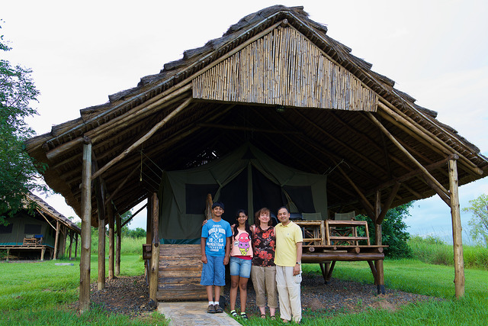
Second Page

Slide 10


